Slide 1
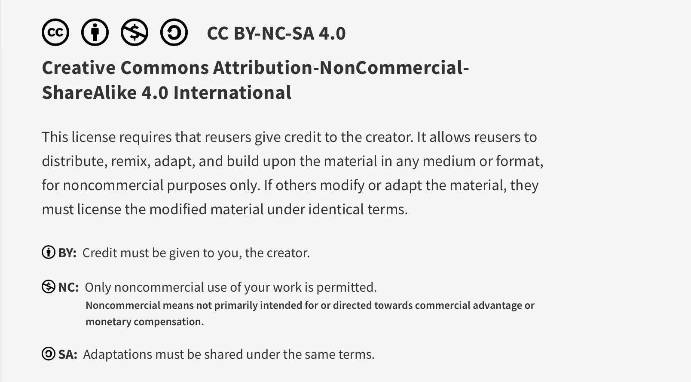
This work is licensed under CC BY-NC-SA 4.0. To view a copy of this license, visit: https://creativecommons.org/licenses/by-nc-sa/4.0/

Slide 2
Intro to Quality Improvement 2 Core program session
Lucie Filteau, MD, FRCPC
PGY 2-4 AHD
QPS Lecture Series

Slide 3
Ottawa Anesthesia QPS Curriculum
PGY 1
PGY 2-4
Intro to Safety
Handover
Stress and Substance Abuse
IPAC Session
Positioning Workshop
Intro to Quality Improvement 1
Intro to Quality Improvement 2
Systems Thinking and Design
Human Factors
Resource Stewardship
Situational Awareness, Teamwork and Communication

Slide 4
This Session
Pre-session material
Choosing the right project
Project exploration, considering scope, feasibility
Developing a project plan
Selecting stakeholders, cause analysis, intervention plan(s), measurement
Consider sustainability of the change
Developing a communication/marketing plan
REB tips
Carrying out the plan
Publishing guidance
Any questions? Comments?

Slide 5
Scenario
There have been several recent adverse event reports felt to be related to residual neuromuscular blockade in PACU (aspiration, resp failure, reintubation)
Your department chair has created this working group to tackle this ongoing issue
Discuss possible contributing factors (to residual NMB) and devise a plan
Select a group recorder and reporter

Slide 6
QI Project Plan – Questions to Tackle
1. Who would you involve in your project (stakeholders)?
2. What do you think is contributing to this problem?
3. Which aspect of this issue would you propose to tackle?
(What/how would you change to produce improvement?)
4. Is the planned change sustainable?
5. What would you measure/track?
6. How would you manage/market the change?

Slide 7
Possible Stakeholders
Dept leadership
Residency leadership
Equipment leadership
Biomed
OR nursing representation (manager/educator)
AA representation
PACU nursing
EPIC/IT data miner
Pharmacy

Slide 8
Possible Contributing Factors (Residual NMB)
Lack of awareness of importance of reversal
Lack of belief in residual NMB data
NMB monitoring not consistently done
NMB monitoring simply not a local practice
Lack of equipment availability
Equipment available but often dysfunctional/unreliable (and no routine Biomed maintenance/support)
Inadequate residency training/supervision
Lack of adequate intraop anesthesia assistance, overwhelming workload
No local policies

Slide 9
Possible Contributing Factors – cont’d
Adequate NMB reversal not consistently done
Lack of insight re factors that prolong NM blockade
Insufficient dosing of reversal
Lack of easy availability of reversal agents (Neostigmine, Suggamadex)
Hospital protocols limiting the use of Suggamadex
Surgeons’ expectations of complete paralysis until the last stitch…
Anesthesiologists’ belief that all intubations require muscle relaxation
Lack of performance feedback (re residual NMB) to anesthesia providers

Slide 10
What to Tackle??
Need more info to pick an intervention!
Discussions with anesthesia providers
Rounds/dept meeting
Informal (lounge)
Survey (exploring practice patterns, knowledge/beliefs, obstacles)
Chart review to explore practice
Walk about to look at
med carts (reversal availability)
Equipment availability/functionality

Slide 11
Contributing Factor
Generous rocuronium doses used for short ETT cases where NMB not required for surgery
Intervention?
Measurement?
Outcome
Process
Balancing

Slide 12
Contributing Factor
Anesthesia providers are not routinely using NMB monitors for cases where NMB is being administered
Intervention?
Measurement?
Outcome
Process
Balancing

Slide 13
Contributing Factor
Pharmacy restricts Suggamadex use to emergency (CICV) situations
Intervention?
Measurement?
Outcome
Process
Balancing

Slide 14
Parting Thoughts
Quality Improvement Parts 1 and 2 are introductory sessions
Many more QI resources/tools available!
Additional training opportunities
CAS website
https://www.cas.ca/en/about-cas/committees/quality-and-patient-safety
Another resource in development
Royal College QI Essential Guidance
https://cpd.royalcollege.ca/learn/courses/51/essential-guidance-for-quality-improvement

Slide 15
Questions?

Slide 16
This work is licensed under CC BY-NC-SA 4.0. To view a copy of this license, visit: https://creativecommons.org/licenses/by-nc-sa/4.0/

